Slide 1
KARNATAKA UNIVERSITY, DHARWAD
MASTER OF COMPUTER SCIENCE (M.Sc. (CS))
Project presentation on
“Langchain chat pdf”
Presented by : Puttaraj. K (p02gi21s0014)
Under the guidance of : venkoba

Slide 2


Content
INTRODUCTION
RESOURCE REQUIREMENTS
ARCHITECTURE OF LANGCHAIN
SYSTEM DESIGN
SCREENSHOT
RESTRICTIONS AND FUTURE IMPROVEMENTS
TESTING
CONCLUSION

Slide 3
introduction
Understanding information in PDFs is tough due to their wealth of data in the modern digital era. Langchain Chatpdf changes how we interact with PDFs by using OpenAI API and free large language models (LLMs). It allows us to ask questions in everyday language and get answers from multiple PDFs. This new method makes searching easier and finding information quicker. Chatpdf, like Langchain, helps businesses stay competitive by providing fast and accurate access to vital information, saving time and money in today's data-driven market.

Slide 4
How a Large Language Model Is Built?
A large language model is a transformer model on a large scale. It is so large that usually cannot be run on a single computer. Hence it is naturally a service provided over API or a web interface. As you can expect, such large model is learned from a vast amount of text before it can remember the patterns and structures of language.
For example, the GPT-3 model that is backing the ChatGPT service was trained on massive amounts of text data from the internet. This includes books, articles, websites, and various other sources. During the training process, the model learns the statistical relationships between words, phrases, and sentences, allowing it to generate coherent and contextually relevant responses when given a prompt or query.
Distilling from this vast amount of text, the GPT-3 model can therefore understand multiple languages and possess knowledge of various topics. That’s why it can produce text in different style. While you may be amazed that large language model can perform translation, text summarization, and question answering, it is not surprised if you consider these are special “grammars” that match the leading text.

Slide 5
Resource requirements
Ram : Min 2 GB or more
CPU : 2 GHz or faster
Architecture :
32-bit or 64-bit
Processor
: Processor – Intel Atom or higher
Hard Disk : Min 500GB or more
Hardware Requirements:

Slide 6
Resource requirements
Software Requirements:
Operating System Compatibility: Windows OS , Mac OS, Linux
Text Editor: VS code , PyCharm, Notepad++
Python: 3.9 version
Python Libraries: Streamlit, PyPDF2, HuggingFace, dotenv
API Key

Slide 7
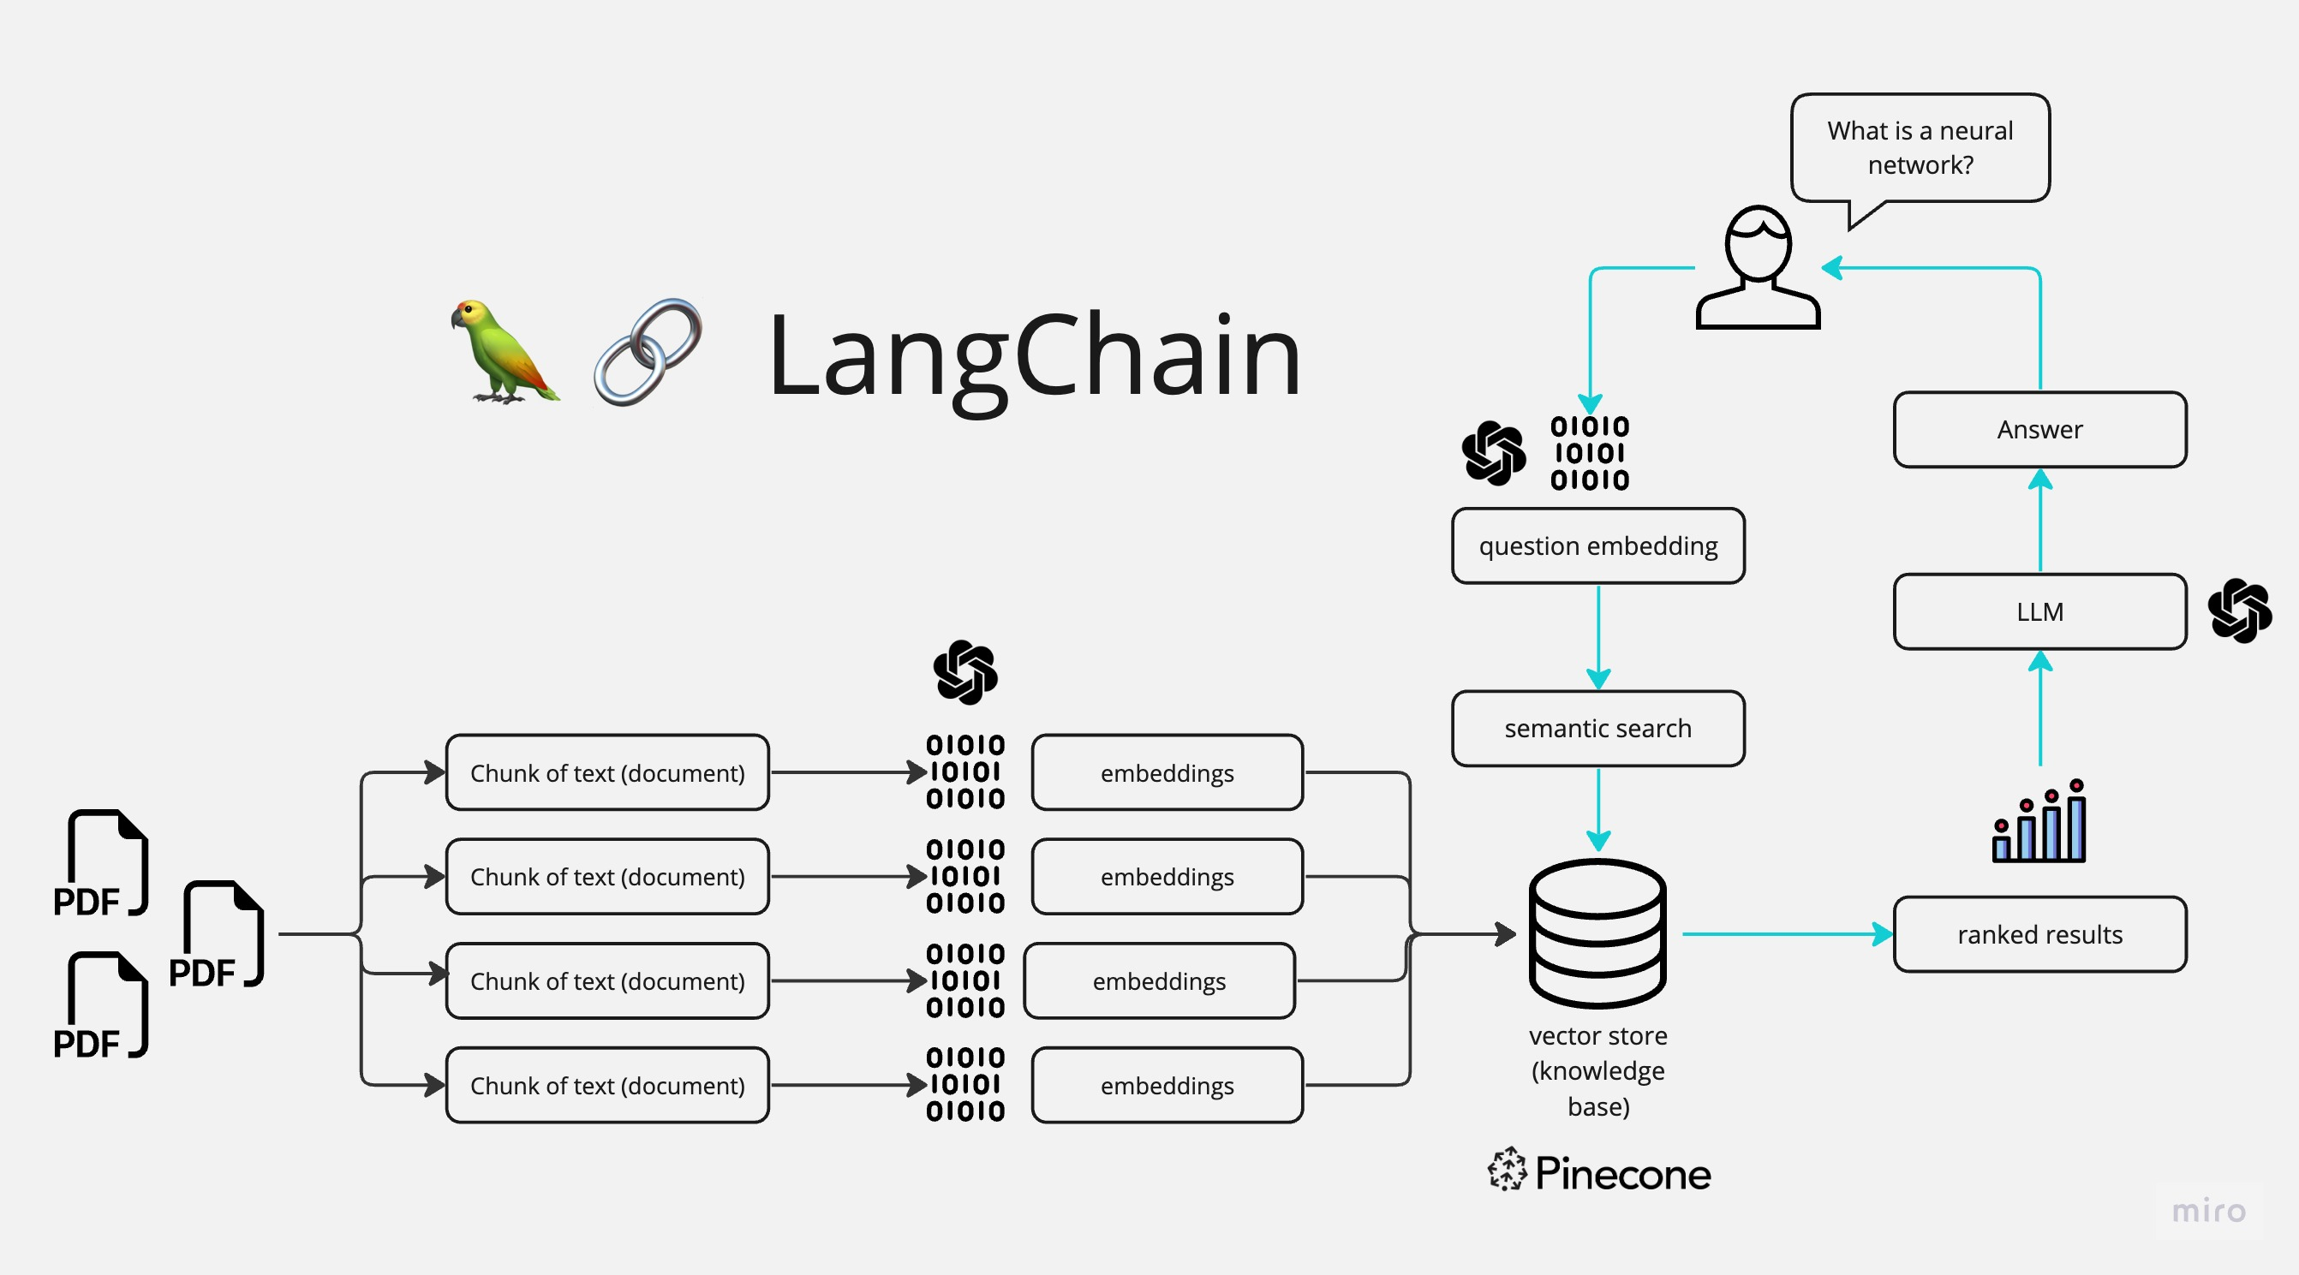
LangChain Architecture

Slide 8
From Transformer Model to Large Language Model
As humans, we perceive text as a collection of words. Sentences are sequences of words. Documents are sequences of chapters, sections, and paragraphs. However, for computers, text is merely a sequence of characters. To enable machines to comprehend text, a model based on recurrent neural networks can be built. This model processes one word or character at a time and provides an output once the entire input text has been consumed.
To process a text input with a transformer model, you first need to tokenize it into a sequence of words. These tokens are then encoded as numbers and converted into embeddings, which are vector-space representations of the tokens that preserve their meaning. Next, the encoder in the transformer transforms the embeddings of all the tokens into a context vector.

Slide 9
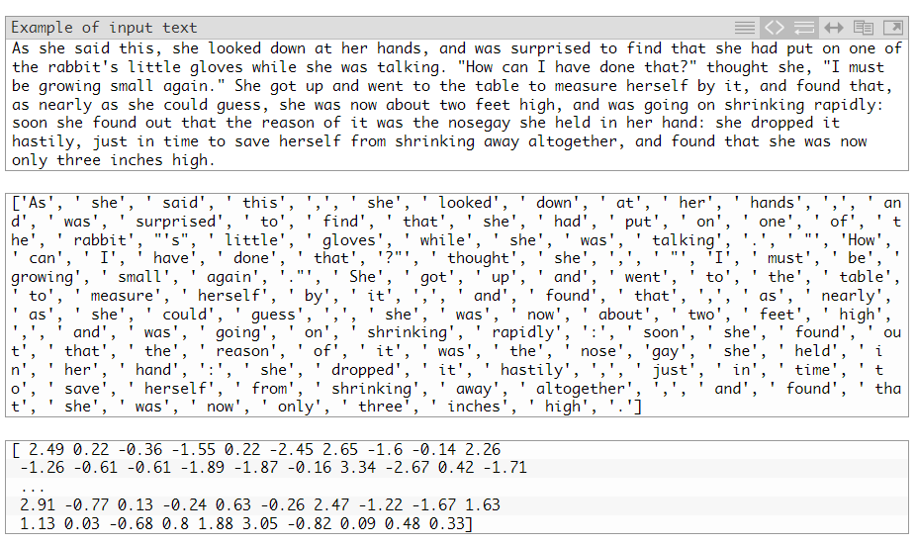
From Transformer Model to Large Language Model

Slide 10
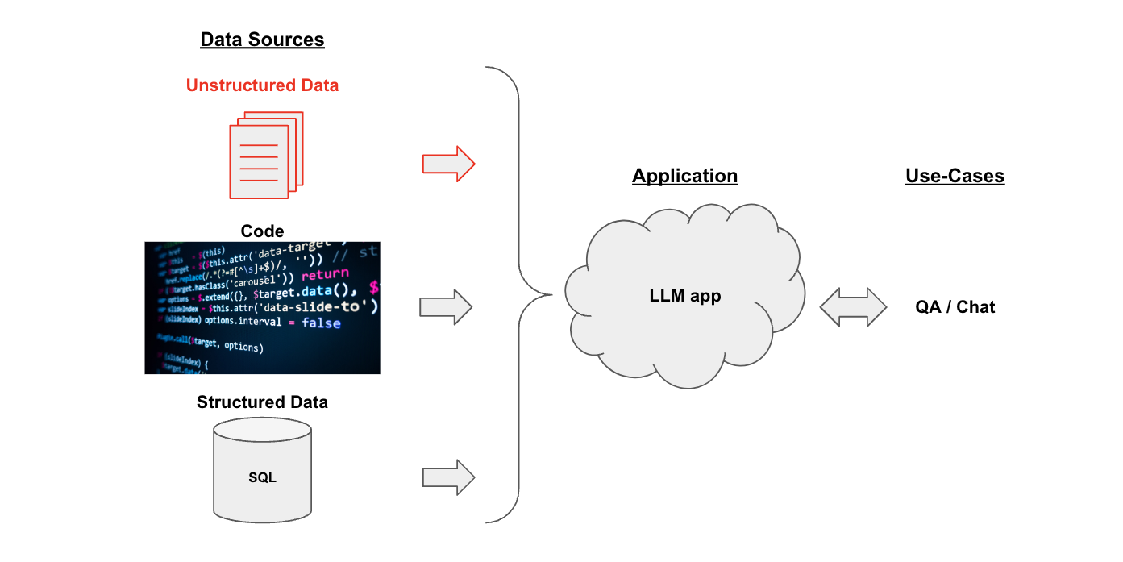
LangChain Architecture

Slide 11
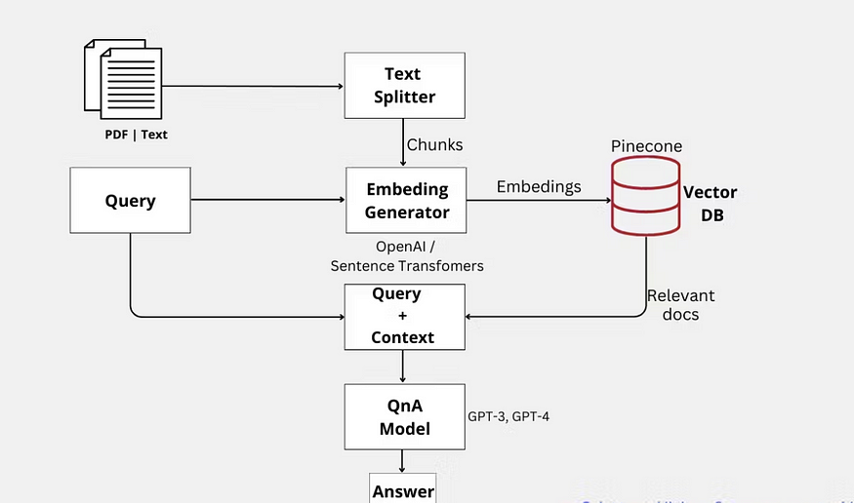
System Design

Slide 12
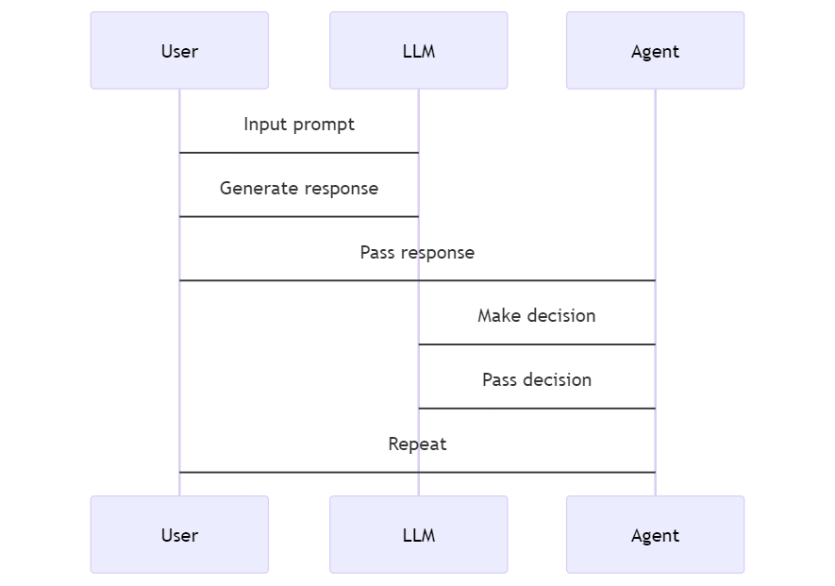
System Design

Slide 13
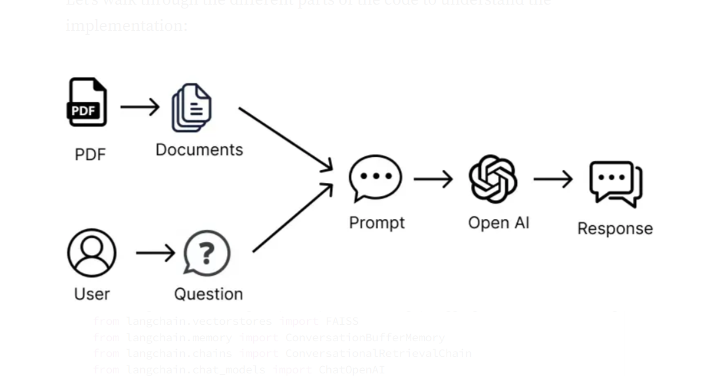
IMPLEMENTATION architecture

Slide 14
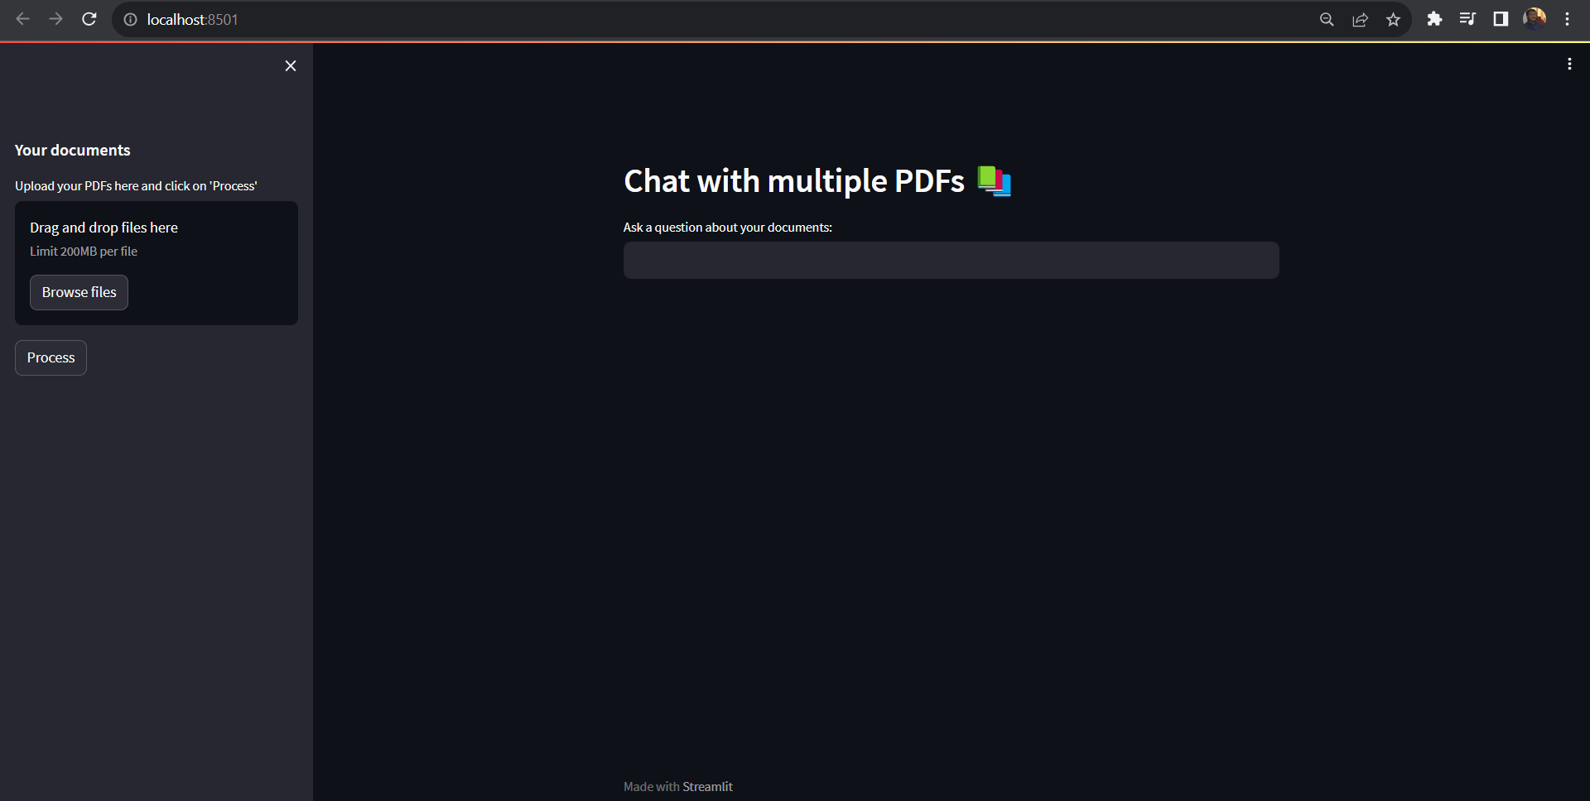
Screenshots of workflow

Slide 15
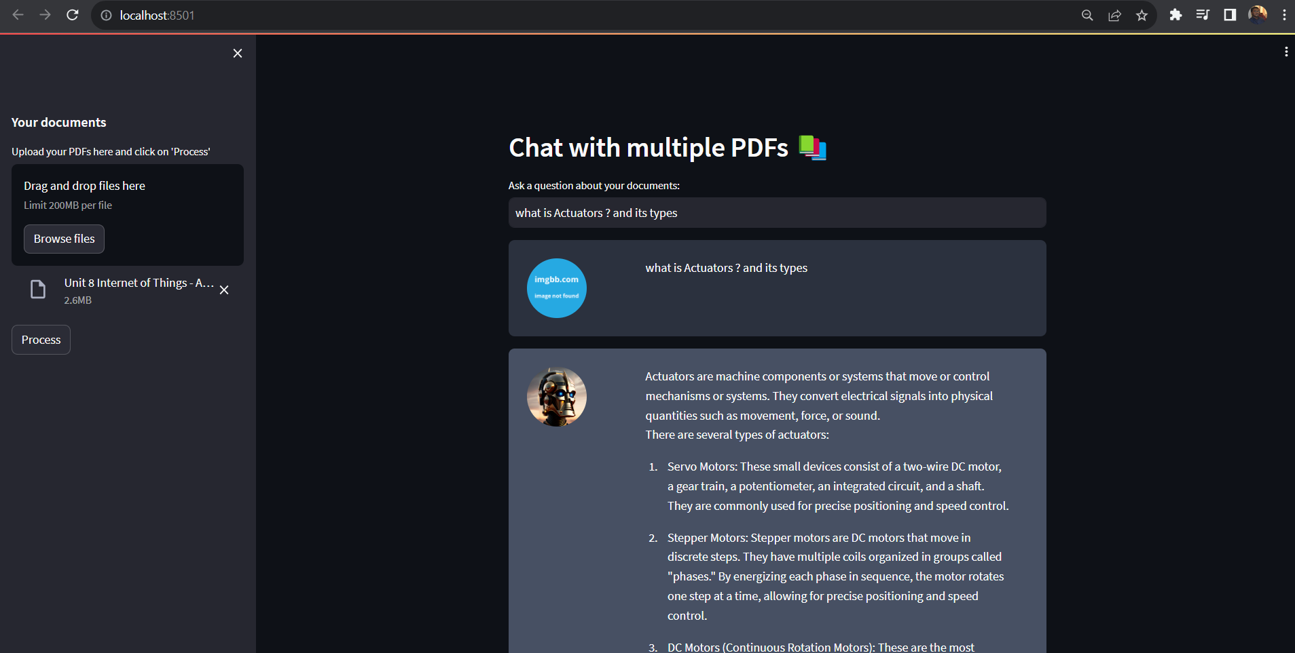
Screenshots of workflow

Slide 16
Restrictions and future improvements
Our current method has some issues, like the 4,096 token limit set by OpenAI, which restricts our ability to transfer data effectively. This can lead to missing important information or even entire documents. To improve, we can explore newer language models with higher token limits for better context. Additionally, we can enhance ChatPDF by supporting various document formats beyond PDFs, improving error messages, and offering customization options for users. These upgrades aim to make ChatPDF more efficient and user-friendly while providing more accurate and extensive information.

Slide 17
testing
Test
Test Case 1: Verify Home Page Display
Test
Test Case 2: PDF Upload
Test
Test Case 3: PDF Processing
Test
Test Case 4: PDF-Based Query
Test
Test Case 5: Non-PDF Query

Slide 18

Conclusion
In conclusion, systematic testing of the embedded web application designed for PDF upload, processing, and query handling has affirmed its alignment with project requirements. This application effectively leverages the OpenAI API to provide relevant answers based on the content of uploaded PDFs while adeptly managing non-PDF queries. The testing results showcase its ability to allow users to upload PDF documents of up to 200MB in size, processing them without errors and promptly notifying users upon completion. Additionally, for PDF-based queries, the application successfully forwards user inquiries related to the content of uploaded PDFs to the OpenAI API, delivering answers that align with the PDF's information. When faced with non-PDF queries, the application exhibits proper handling by refraining from processing them through the OpenAI API and instead delivering informative messages to users, indicating the absence of relevant information. Overall, this embedded web application efficiently fulfills its intended objectives, offering a valuable solution for users seeking AI-powered assistance in extracting insights and answers from extensive PDF documents, while ongoing optimization efforts can further enhance its performance and responsiveness under various conditions.

Slide 19


Thank YOU

